Slide 1

IPC Parent Presentation
St. Luke’s Academy
Notes:
We recommend you use these slides as a guide to present information about the IPC to parents. Where possible please include school-specific information and your own images. Prompts for these will be included in the slide notes.
This version includes videos of IPC teachers talking about different aspects of the curriculum.
Slide notes
Welcome slide – add your school’s name as a subtitle.

Slide 2
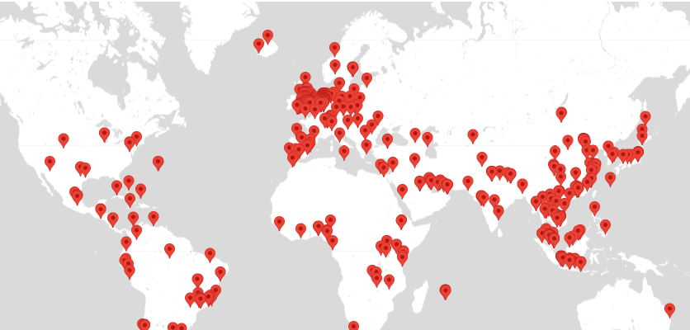
IPC is Taught and learned around the world
Over 80 countries
Nearly 1000 IPC Schools
Over 13,000 teachers
Dutch National Schools
UK state schools and academies
Notes:
Slide notes
This is from the International Curriculum Association website, the map on the website is interactive showing schools in countries and regions for each International Curriculum programme.
The IPC is an internationally researched curriculum for learners aged 5-11 years old, presented to schools through core documentation, practical materials and supporting resources. Although it is regularly updated it has just undergone a rigorous review with updated learning goals, units and core documents.

Slide 3



The International Curriculum Association
Notes:
Slide notes
When we refer to the ICA, International Curriculum Association we are encompassing all three curricula, professional development and the Recognition and Accreditation service.
This presentation will focus on the IPC.

Slide 4
What is the IPC?
A philosophy (what we believe about learning)
A pedagogy (an approach to teaching)
A process (that best facilitates learning for this age group)
Our philosophy, pedagogy and process are all aimed at improving learning for all.
Notes:
Slide notes
Central to the International Curriculum is the belief in, and commitment to, the holistic development of learners through enjoyable academic, personal and international learning that prepares them for opportunities and challenges now and in the future.

Slide 5
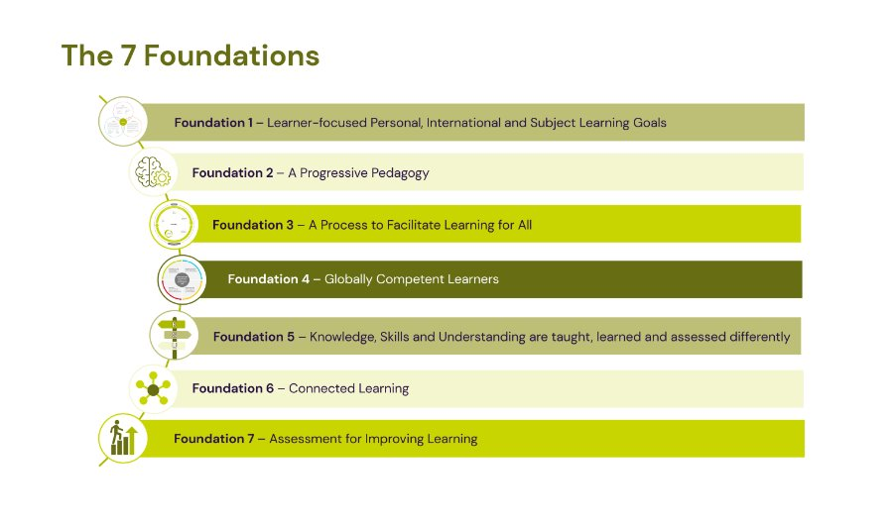
Notes:
Slide notes
These are the seven foundations of the IPC, they are research influenced and provide a complete concept of curriculum – beyond just what needs to be learnt and how it can be taught.
The International Curriculum aims to improve learning in schools by supporting teachers and leaders through the provision of internationally researched curriculum materials and engaging units of learning.

Slide 6
Learning is the process of extending and consolidating our neuronal connections as we acquire knowledge, develop skills and deepen our understandings.”
ICA Definition of learning
Notes:
Slide notes
The ICA definition of learning.
SUGGESTION
You can replace this with the definition from your school if you have one.

Slide 7
Through the IPC, which supports teachers and leaders, learners are encouraged to be informed, globally competent, future-ready, socially conscious and motivated to positively contribute within a local and/or global context.”
The IPC Vision for Learners
Notes:
Slide notes
Through the combination of subject, personal and international learning learners should be ready to make the most of learning opportunities now and in the future which may lead to engaging in responsible action.
SUGGESTION
You may wish to add you own vision/mission on a new slide after this one and mention any commonalities.

Slide 8
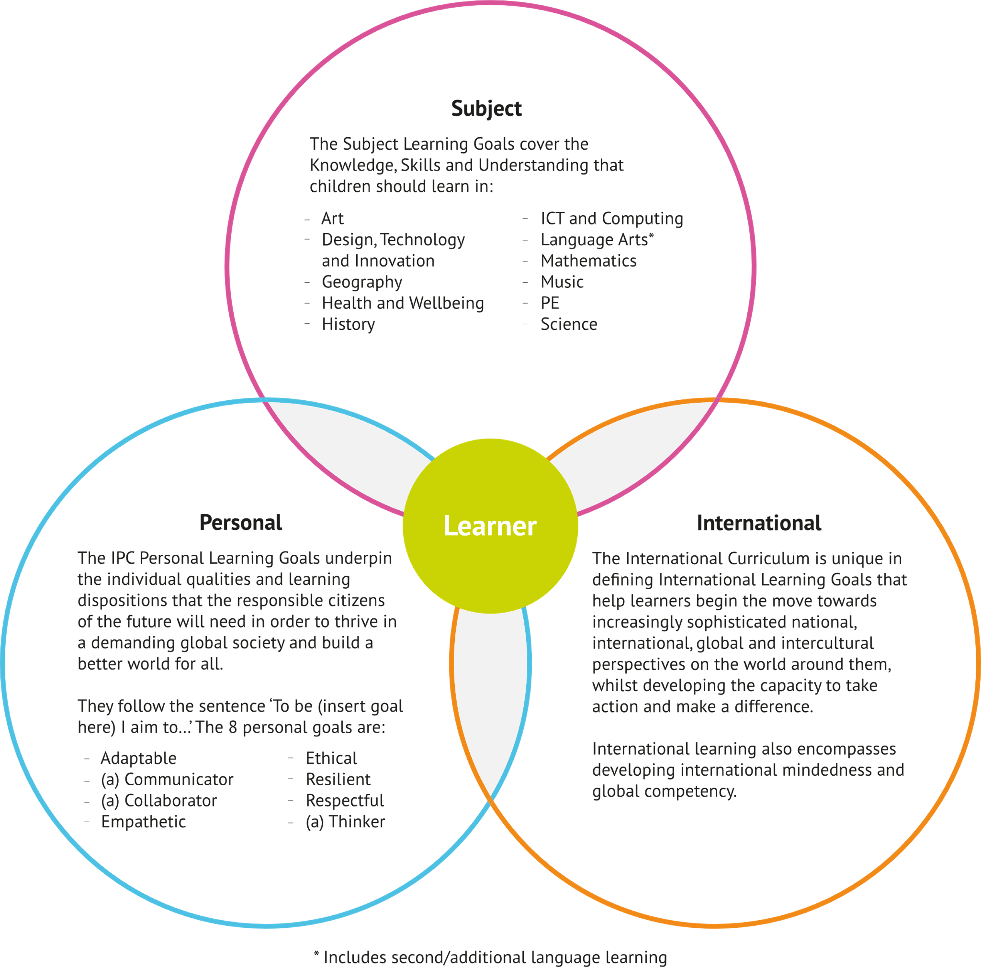
Areas of Learning
Notes:
Slide notes
The Learning Goals are organised into 3 distinct but connected sections. The IPC Learning Goals are central to the IPC. The clear, precise Learning Goals give schools, teachers and leaders the chance to do that much more easily.

Slide 9
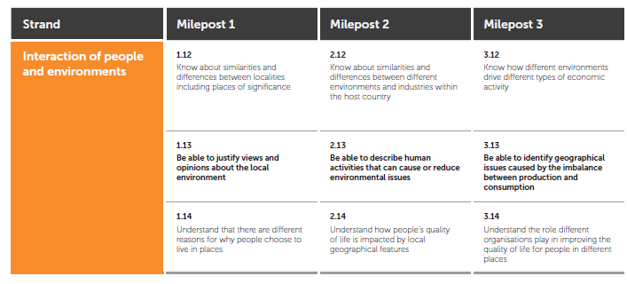
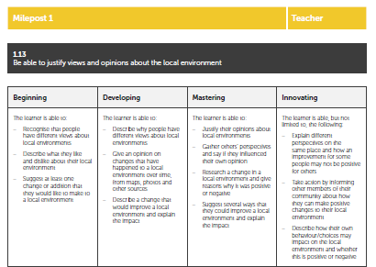
Sequenced learning goals
Subject, Personal and International
Assessment Improving Learning Toolkit
Rubrics & Learning Advice
Notes:
Slide notes
The IPC provides teachers with a set of sequenced learning goals to ensure progression throughout the primary years, an assessment for improving learning toolkit with rubrics for teachers and children and learning advice to help improve learning.
SUGGESTION
If you are using the rubrics, explain more about these and how they support assessment.
It is important to identify that each learner is making progress with regards to learning. Rubrics for Key Skills have four levels, with mastering equating to confident, consolidated performance and an anticipated end of milepost goal. Innovating is for learners who go above and beyond grade-level expectations.
The following are all encouraged when using the rubrics:
Self-assessment against the children’s rubrics, goal setting driven by the Learning Advice.
Peer-assessment using the rubrics and generating feedback based on the Learning Advice.
Teacher assessment against the teacher rubrics, feedback guided by the Learning Advice.

Slide 10
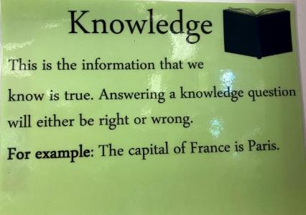
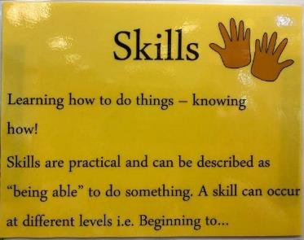
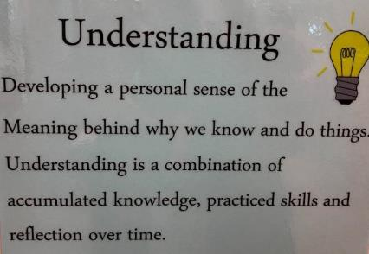
Types of learning
Knowledge
Skills
Understanding
Notes:
Slide notes
The subject learning goals are made up of Knowledge, Skills and Understanding that children will develop.
SUGGESTION
If you have definitions or image prompts for knowledge, skills and understanding add those to this slide.
Alternatively, add examples of each type of learning goal from recent learning.

Slide 11

Subject Learning
Art
Design Technology and Innovation
Geography
Health and Wellbeing
History
ICT and computing
International
Music
PE
Science
Language Arts
Mathematics
Notes:
Slide notes
Thematic units are designed to help children to see how subjects are both ‘independent’ and ‘interdependent,’ just like they are in real life. Learning is improved through making connections between subjects, to their own lives and talking about a theme from different subject viewpoints.
International learning is a broader area, but IPC is unique in providing International Learning goals.
Language Arts and Maths goals and activities for these are included in subject learning task as opportunities for connecting learning.
SUGGESTION:
You should explain whether you use the IPC Maths and Language Arts goals and if you have any single-subject teachers, how they use IPC goals and/or units.

Slide 12
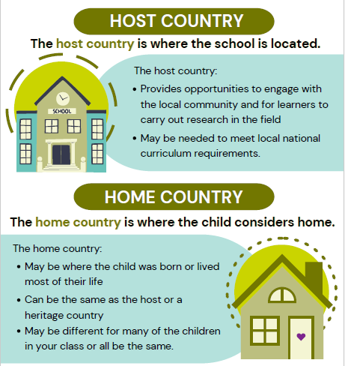
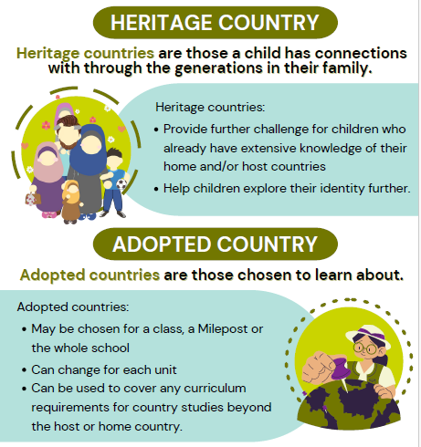
International Learning
Notes:
Slide notes
International Learning is one of the three key IPC areas of learning; the ICA is unique in defining International Learning Golas.
Each thematic unit has international tasks where learning relevant to the theme is considered locally and globally often through host, home and adopted countries. Thinking about these countries may also be included in subject tasks to allow learners to make connections between subject learning and home and/or host countries.
International Learning goes beyond the units and will be evident in the school. It aims to develop a sense of ‘international mindedness’ and ‘global competency’ which encourages taking action in the local and global community.
SUGGESTIONS: Explain the host and home countries in your school and if these are the same how you might use adopted countries.

Slide 13
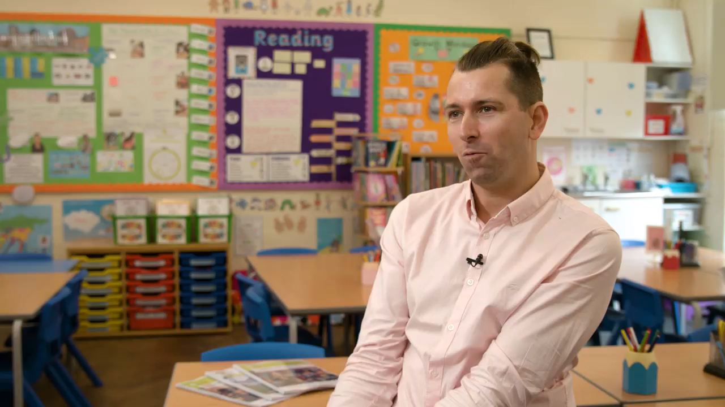
Notes:
An IPC teacher talks about international learning.

Slide 14
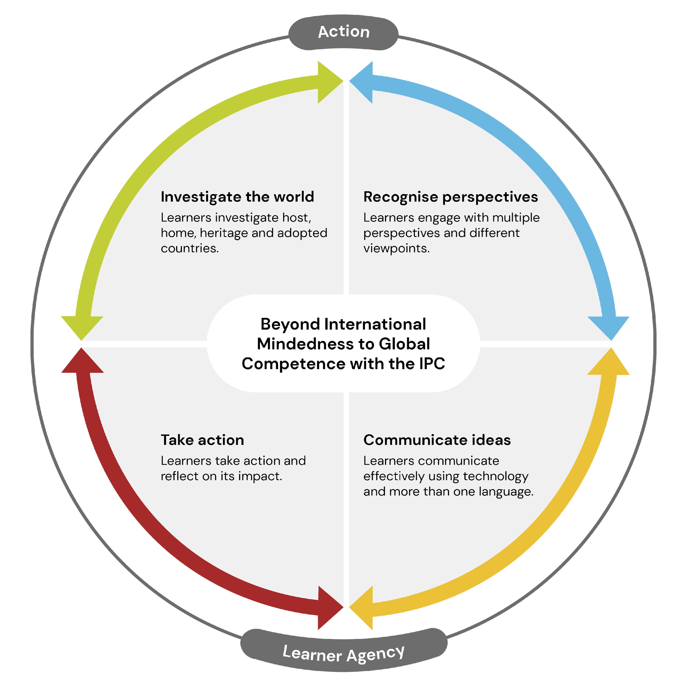
Globally competent
Is engaged with shaping local and global communities
Is an agent of positive change
Is empathetic and demonstrates kindness to others
Collaborates positively with everyone and anyone
Communicates effectively in more than one language
Reflects on how their choices may contribute to or exacerbate local or global issues
Seeks feedback to understand whether intended outcomes were as anticipated.
Adapted from the Framework for global competence (Boix Mansilla and Jackson, 2013)
Notes:
Slide notes
As well as gaining Knowledge, Skills and Understanding through International Learning children should become internationally minded and globally competent.
Learners will have the opportunity to develop a curiosity for the world around them and the appreciation of different viewpoints.
To become more globally competent, learners should be encouraged to take positive action locally or globally, for example by protecting and preserving the environment, responding positively to social issues and sharing their learning with others.
SUGGESTION
If your school has defined international mindedness and/or global competence adapt this slide.

Slide 15
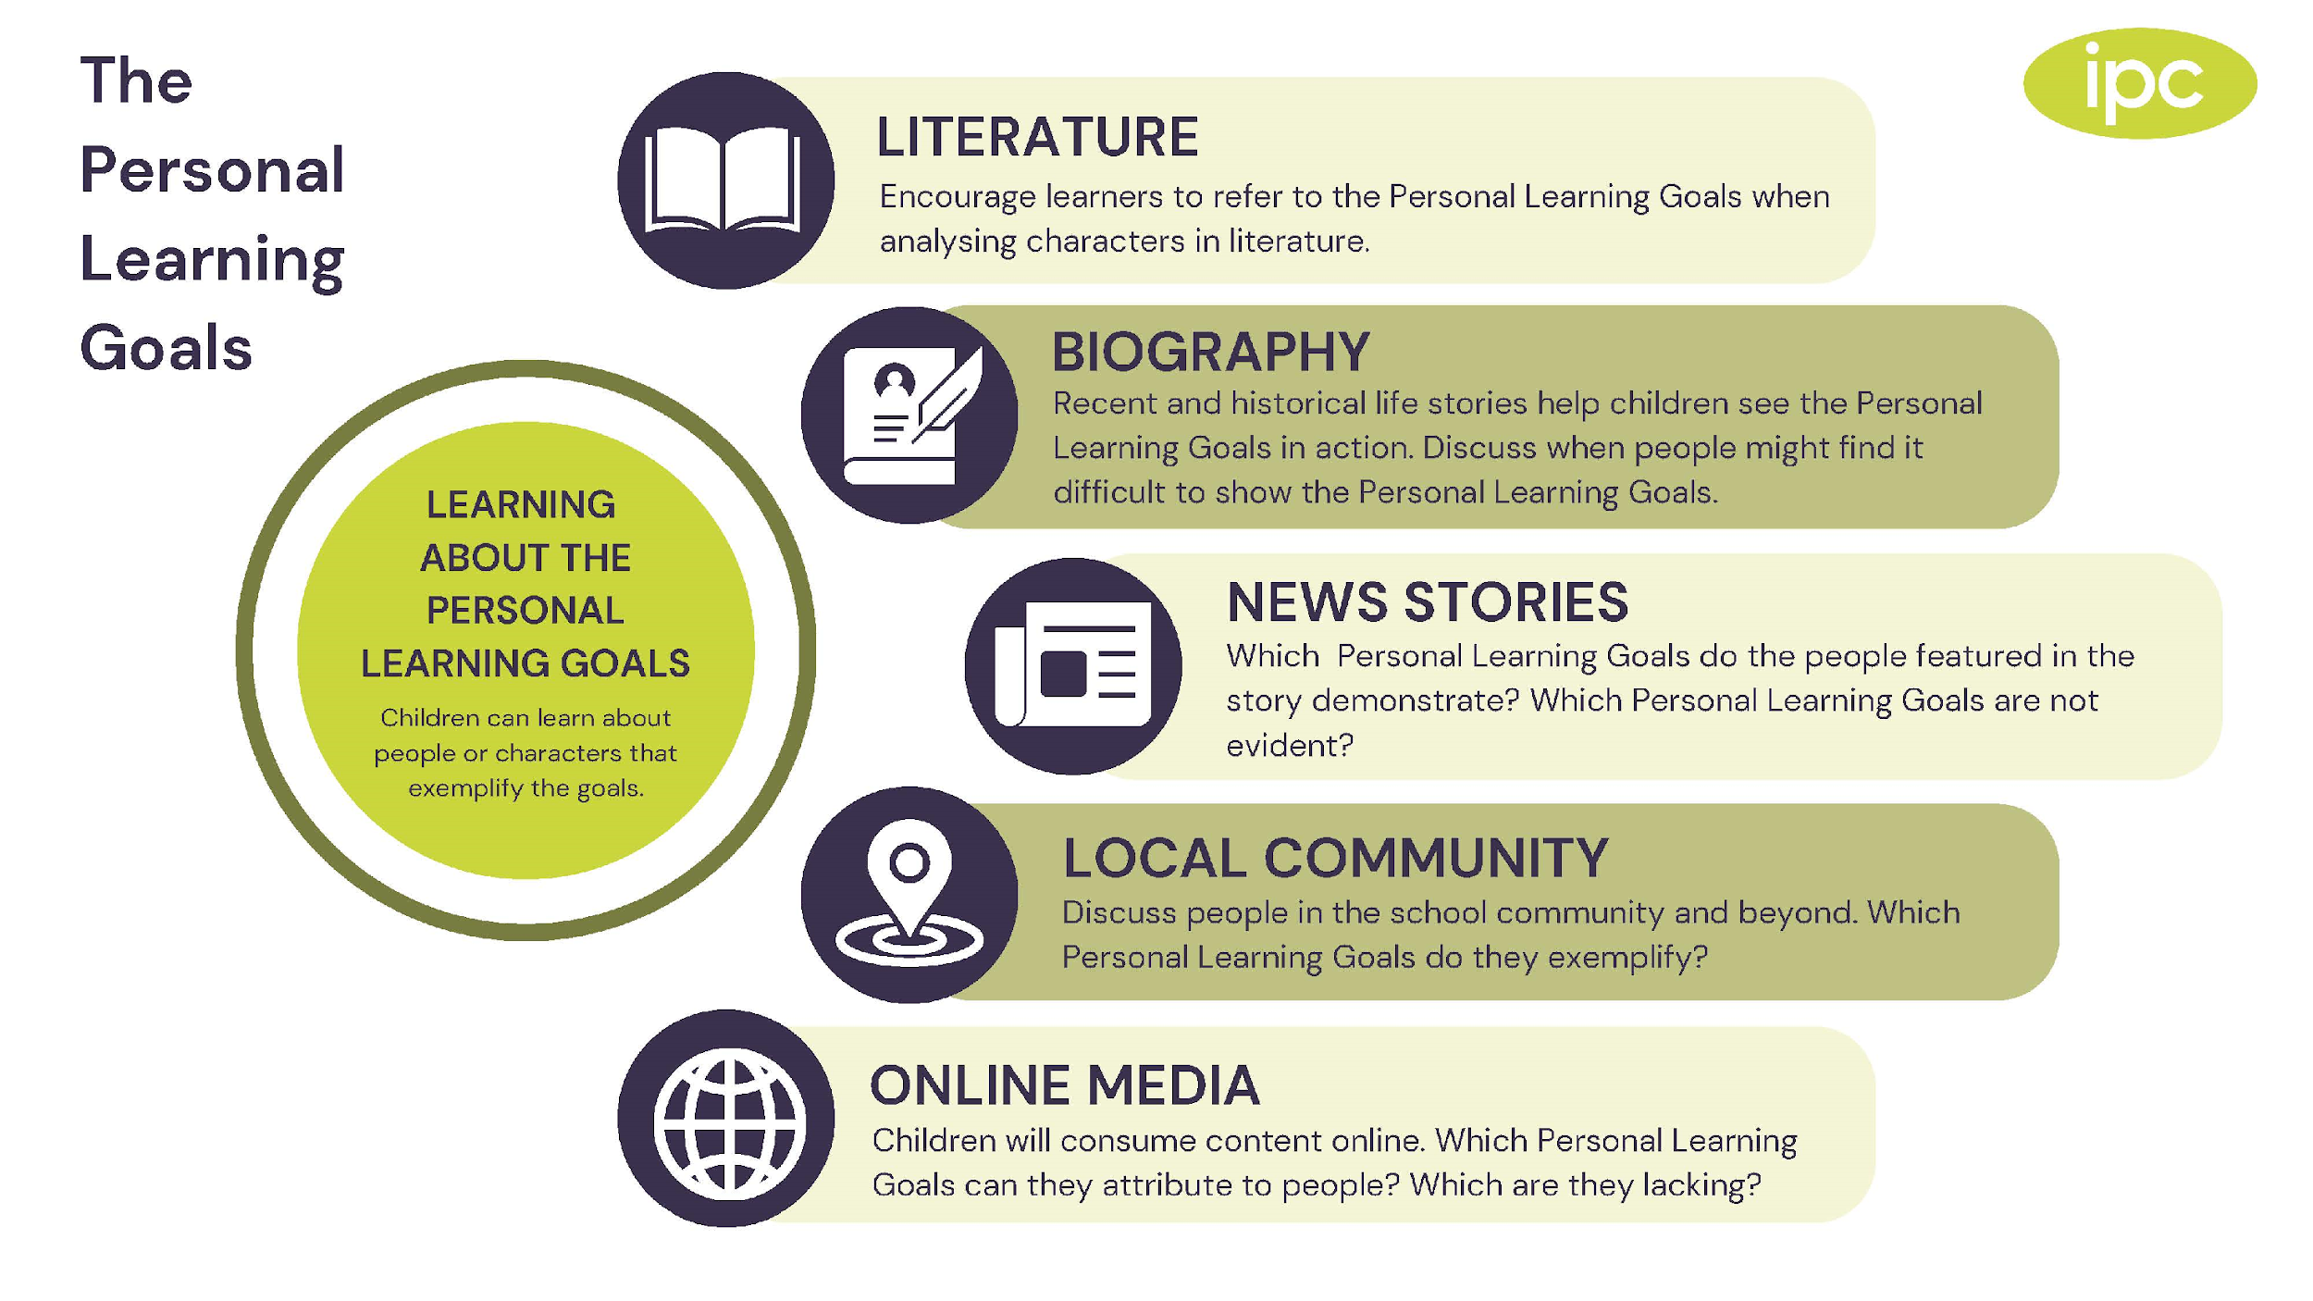
The Personal Goals
Adaptable
Empathetic
Ethical
Resilient
Respectful
A communicator
A collaborator
A Thinker
Notes:
Slide notes
The Personal Learning Goals shape our attitudes and capabilities as learners and people. They will help learners to flourish and overcome challenges in life and learning.
The aim of the Personal Learning Goals is to develop character and attitudes, rather than Knowledge, Skills and Understanding.
These goals are included in unit tasks so that children learn about what they mean and put them into practice.
The Personal Learning Goals apply to all school activities, not just IPC lessons.
The infographic gives ideas that parents can use to support the Personal Learning Goals at home.
SUGGESTION
You may want to explain how you recognise children using the Personal Goals or if you have a monthly or termly focus.

Slide 16
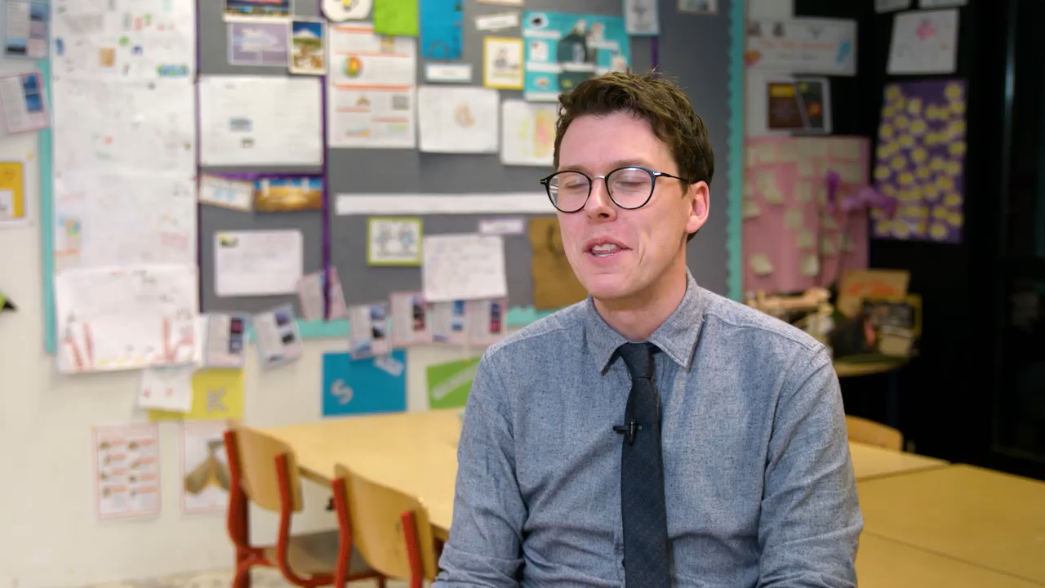
Notes:
Here an IPC teacher talks about the importance of the Personal Learning Goals.

Slide 17
The Personal Goals at St Luke’s Academy
Notes:
SUGGESTION
Add examples of PLG displays and definitions from your school.

Slide 18
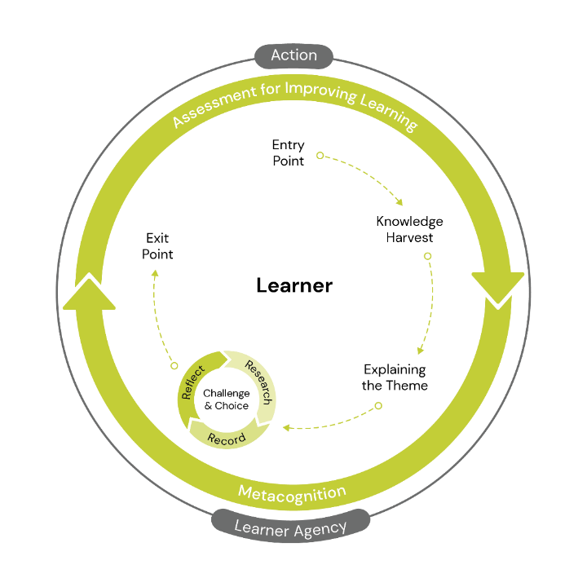
The Process to Facilitate Learning
Notes:
Slide notes
Although learning is different for everyone each unit follows the same Process to Facilitate Learning which has been designed based on neuroscience and educational research to improve learning for everyone.
Assessment can happen at any time in the process of learning. As well as action which is encouraged in response to learning.
We will talk through the cycle and share examples of each stage.

Slide 19

Entry Point
The hook to motivate learning
Activates prior knowledge
Makes learning fun which is motivating
Stimulates curiosity
Notes:
SUGGESTION
We have included pictures from the Pinboard on the next few slides, but recommend you swap these for photos from your school.
Slide notes
The Entry Point happens at the beginning of the unit. It could involve new experiences, a visit or visitors or a hands-on experience organised by the teacher. The Entry Point provides an exciting introduction to the learning that is to follow.
SUGGESTION: You can change the pictures to ones from your school, or describe upcoming Entry Points.

Slide 20
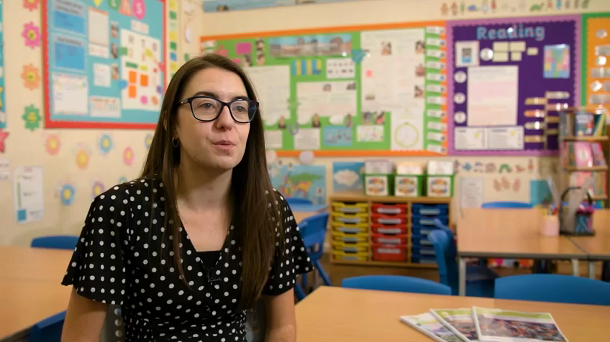
Notes:
An IPC teacher explains the Entry Point.

Slide 21
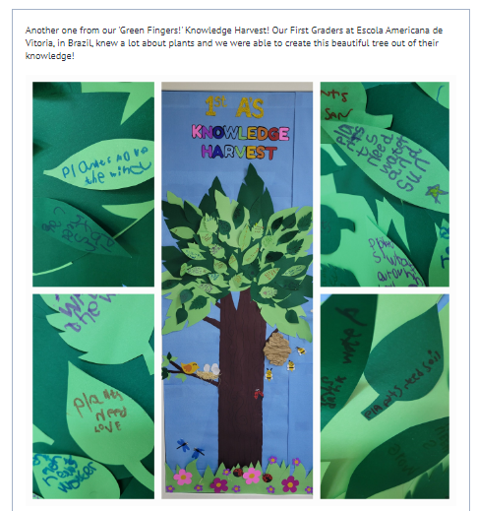
Knowledge Harvest
What do children already know?
Helps to make connections with previous learning
What do children want to know?
Makes learning relevant
Notes:
Slide notes
The Knowledge Harvest is designed to take place in the early stages of each unit and provides an opportunity for children to reveal what they already know about the themes they are studying. This knowledge can then be added to, developed and even challenged by the teacher, throughout the course of the unit.
SUGGESTION: You can change the pictures to ones from your school.

Slide 22
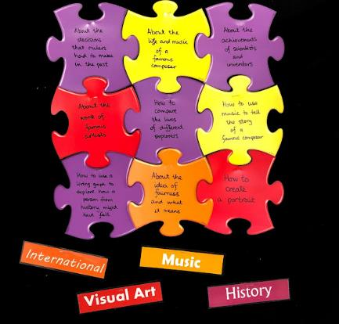
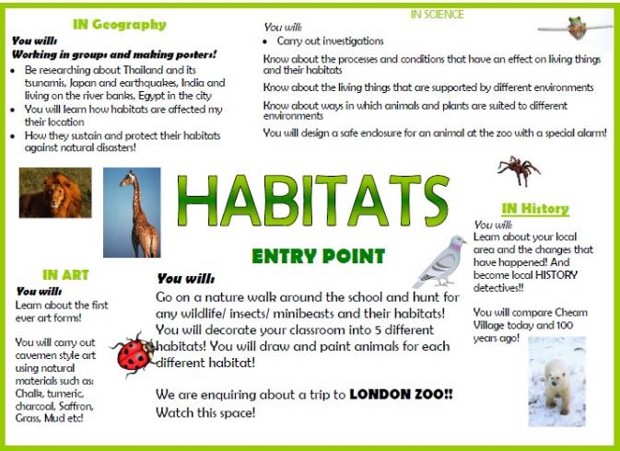
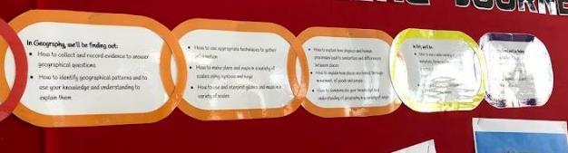
Explaining the Theme
Notes:
Explaining the Theme aims to prepare learners by helping them see how this unit connects with other units of learning, how this unit might build on previous learning and what connections between subjects will be made in this unit of learning. It gives children an overview of where learning is headed.
It is also included in the parent letter at the start of a unit to help support the learning at home
SUGGESTION
Add an image of a parent letter or newsletter with IPC unit announcements.
Add display photos to show connections between subjects and/or the overview of the unit.

Slide 23

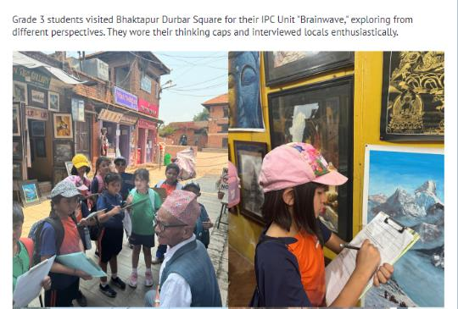
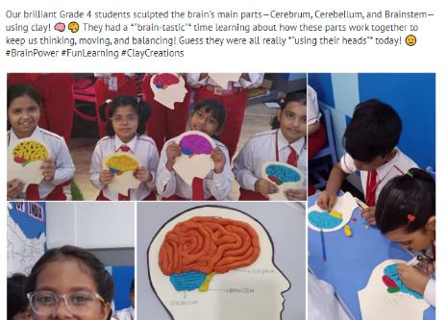

Research, Record, Reflect
RESEARCH
RECORD
REFLECT
Notes:
Slide notes
Each IPC unit has a research activity and a recording activity.
Research activities always precede the recording activities. During research activities, children use a variety of methods and work in different group sizes to find out a range of information.
During the recording activities, children interpret the learning they have researched and have the opportunity to demonstrate, share and explain their learning in different ways.
When reflecting learners may make connections to previous learning, consider the significance of what they have learnt or make personal connections. Reflection is essential to developing metacognition which makes children become better learners.
SUGGESTION:
You can change the pictures to ones from your school.

Slide 24
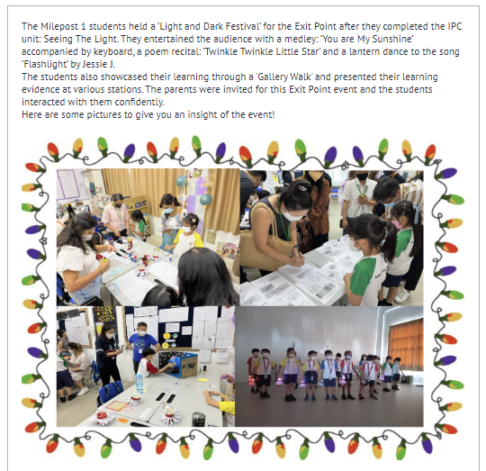
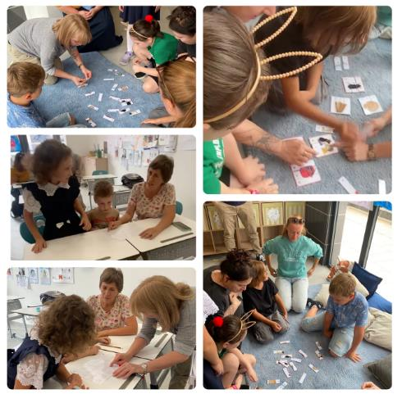
Exit Point
Notes:
Slide notes
The Exit Point has two main purposes: to help children pull together their learning from the unit and to celebrate the learning that has taken place.
SUGGESTION: You can change the pictures to ones from your school.

Slide 25
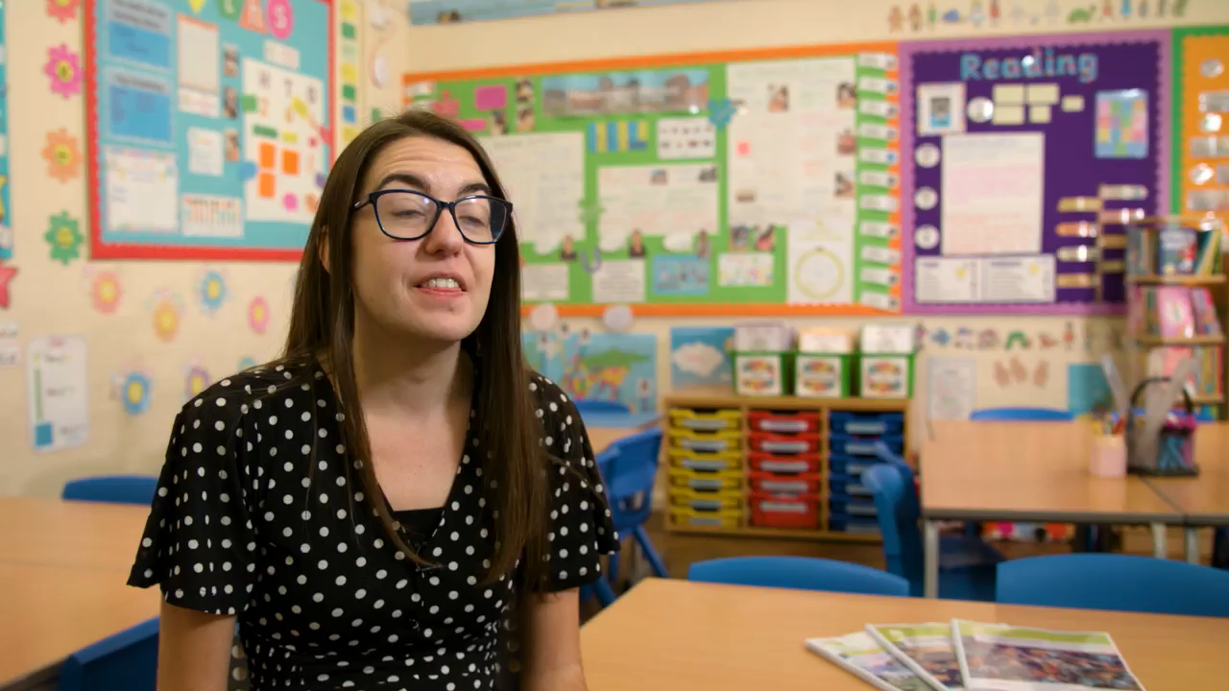
Notes:
An IPC teacher explains the Exit Point.

Slide 26
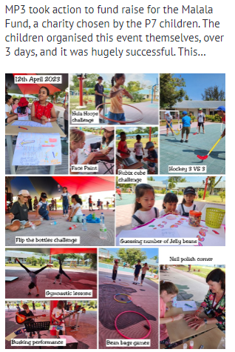
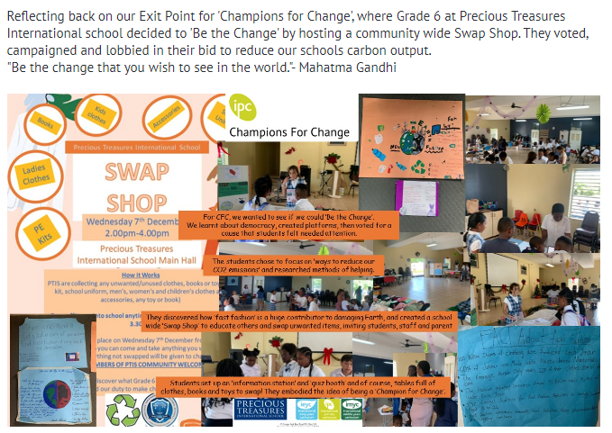
Taking Action
Notes:
Action can be taken at any time within the Process to Facilitate learning.
Children may advocate for action during the Exit Point.

Slide 27
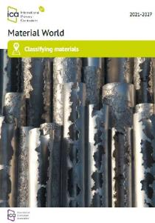
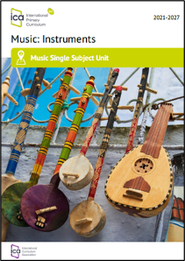

Over 150 engaging units
What did you learn today?
Milepost 1 for 5-7 year olds
Milepost 2 for 7-9 year olds
Milepost 3 for 9-112/12 year olds
Over 130 Thematic units
Single subject units
SDG Challenge series
Notes:
Slide notes
The IPC provides teachers with thematic units of learning, which outline key activities and tasks that follow the process to facilitate learning. The units of learning are specifically designed for each ’milepost’ on appealing themes that motivate learning and cover goals of age-appropriate learning.
We encourage schools, teachers, learners and parents to talk about learning rather than activities.

Slide 28
How you can get involved!
Look out for the parent information letter to find out about the next IPC unit
Supply resources from the home and host countries if available
Join in with Entry and Exit points
Talk to your children about their learning
Recognise and celebrate the Personal Learning Goals at home
Support children in taking action in response to their learning
Notes:
Slide notes
Adapt the bullet points to include how parents can get involved at your school.
SUGGESTION:
Add school specific information here.

Slide 29
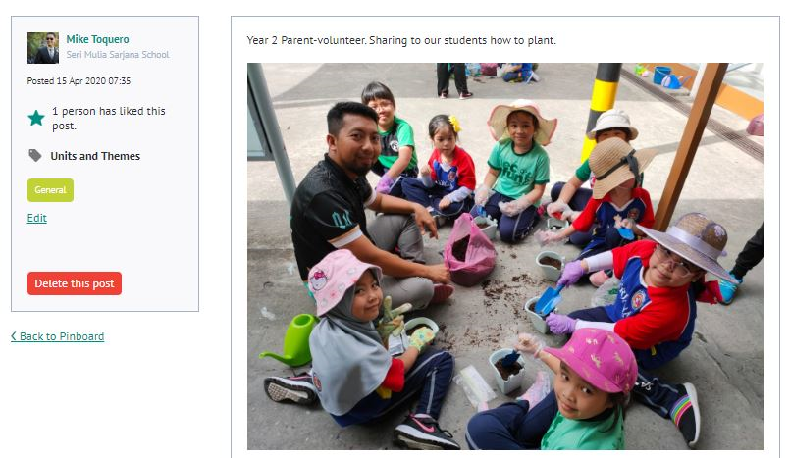
How you can get involved!
Notes:
SUGGESTION:
Change the picture to one from your school showing how parents are getting involved.

Slide 30
Find out more
Notes:
Talk about where parents can find information on your website or school displays.

Slide 31
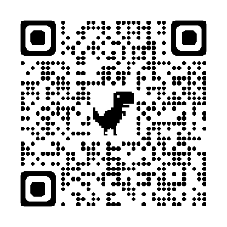
Notes:
The QR code can be included to allow parents to read more once the session is over.

